Slide 1

Causation, Covariation, Correlation
Dr Oliver Clark

Slide 2
Learning Outcomes
Understand the distinction and relationship between the three C’s
Draw a basic graphical model
Interpret correlations visually and numerically

Slide 3
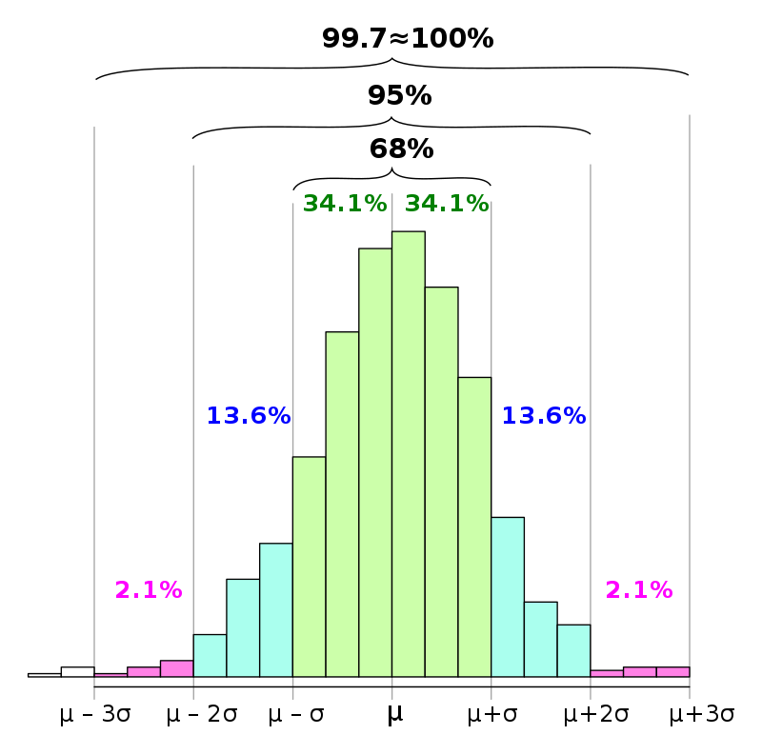
Variance
Notes:
We defined variance last week as the average distance of a set of data-points from the mean

Slide 4
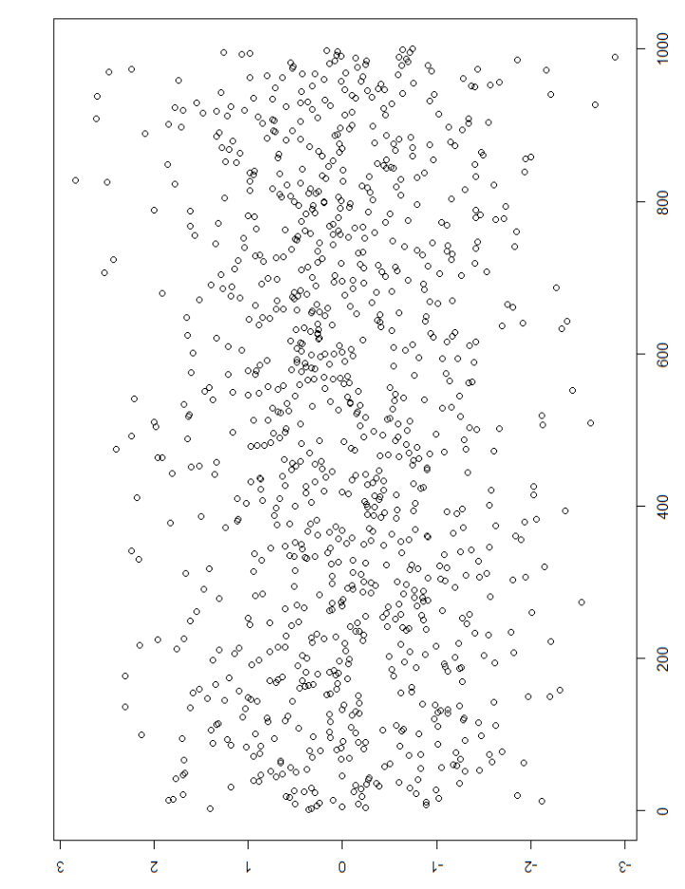
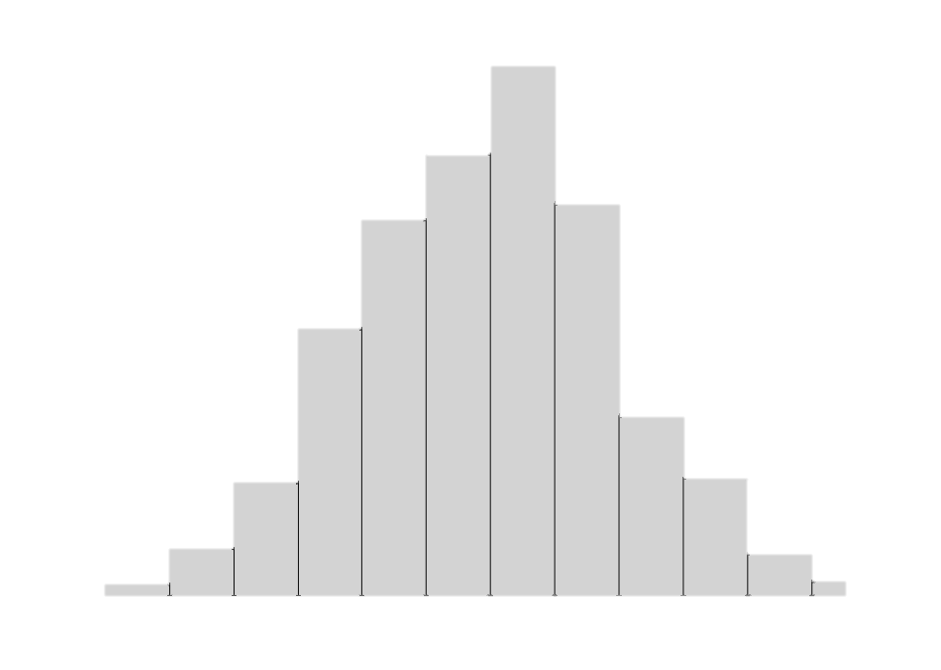
Variance
Notes:
We defined variance last week as the average distance of a set of data-points from the mean

Slide 5
Variance
[Co]
Sum of observation minus the mean squared
Divided by number of scores
Sum of:
(observation 1 minus mean 1) squared, multiplied by (observation 2 minus mean 2) squared
All divided by number of scores
Notes:
We defined variance last week as the average distance of a set of data-points from the mean

Slide 6
Notes:
This person has scored exactly the mean on both measures. The difference from mean 1 is 0 and the difference from mean 2 is 0. If the distance between the mean on both measures is identical for all participants then the covariation will be precisely zero
This next person scored exactly the mean on measure 1 and 2 standard deviations above the mean on measure 2. The difference between the participant and the mean in measure 2 is positive, and the difference between the participant and the mean in measure 1 is 0. If somebody scores exactly the mean on one score and not on the other then the covariation will be zero.
This person has scores above the mean on both scales – when someone scores higher than the mean on both scales, there is a positive covariation between the two measures.
This person has scored above the mean on measure 1, but below the mean on measure 2 – this pattern results in a negative covariation.
This person has scored below the men on measure 1 and below the mean on measure 2 – this actually indicates a positive covariationbetween the two measures

Slide 7
Covariation
Does not tell us anything about magnitude of relationship between two variables
Can be on totally different scales of measurement – e.g. extraversion * conscientiousness ^2 (what does that even mean?)
We can standardise covariation much like we made z scores last week by dividing by the product of standard deviations

